Slide 1
Unlock The Power Of Every Visit With Visitor IQ.
Discover who's browsing your site and boost your lead conversion with Visitor IQ's comprehensive visitor identification and marketing automation.

Slide 2

Enhance Engagement & Drive Conversions.
According to Marketo, 98% of potential customers on business websites are completely anonymous unless they register, subscribe to a newsletter, or fill out a form with their contact information. Without anonymous visitor tracking, you're left to rely on chance for unknown visitors to progress through your marketing funnel.

Slide 3

Fuel Lead Conversion & Business Growth.
Visitor IQ is a powerful suite of tools that empowers businesses to transform your website traffic into valuable leads. By harnessing the power of data-driven insights, Visitor IQ helps you uncover the hidden revenue opportunities within your anonymous website visitors, boosting your lead conversion and fueling your business growth.

Slide 4
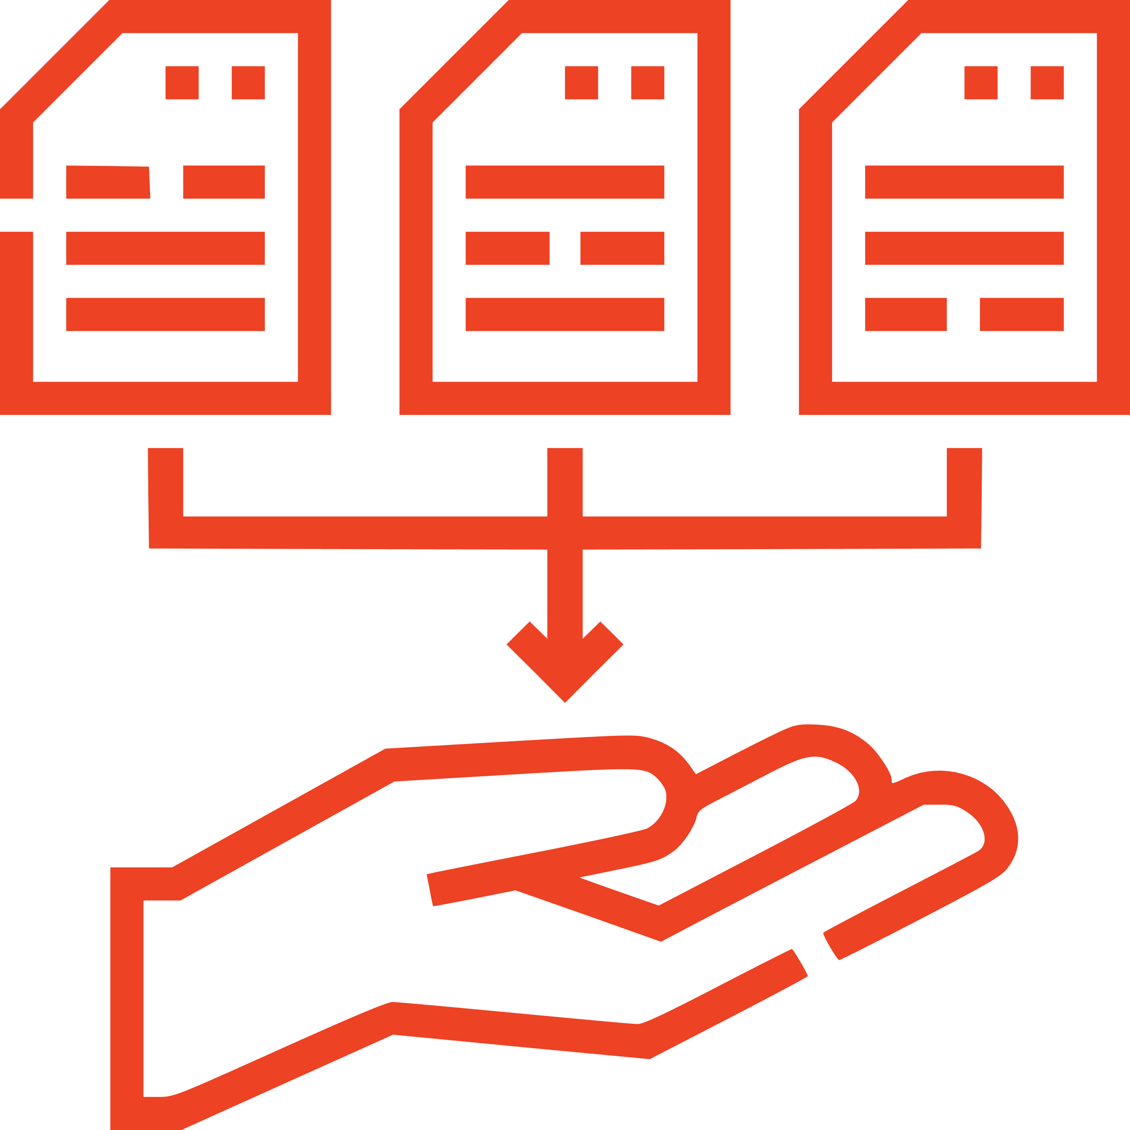




The Visitor IQ Process: Maximizing Lead Conversion.
Collect
A person visits your website, triggering Visitor IQ's data capture and identification. Providing a rich understanding of your visitors' behavior and intent.
Analyze
The platform's powerful algorithms analyze the collected data, identifying valuable leads and filtering out irrelevant traffic, such as bots and automated systems.
Integrate
Visitor IQ seamlessly integrates with your CRM system, automatically updating visitor details and ensuring a streamlined lead management process.
Engage
Based on the insights gathered, Visitor IQ initiates personalized email outreach and nurturing campaigns, effectively engaging with your identified leads and driving them further down the sales funnel.
Send
Export and forward the CSV file to your organization or mailing vendor for postcard processing.

Slide 5

Transform Your Website Into a Lead Generation Powerhouse.
Who’s Visiting & What They’re Viewing
Get details like Name, Address, Email, Gender, and more. Plus, see exactly which pages they’re viewing, and how many times.
Automated Outreach
Send visitors 1-3 personalized emails about your organization starting the next day.
Help your customers understand what sets your organization apart in your industry.
Better Qualified Leads
Set up to 10 unique filters to turn your leads into high-quality opportunities.
Visitor Data Available 24/7/365
All visitor data is seamlessly integrated into your CRM, accessible and downloadable anytime.

Slide 6





Are You Ready to Know Your Visitors?
Visitor Identification
ID of anonymous website visitors and real-time integration into CRM.
CRM Access
Insights into who's visiting your site with access to critical data like names, emails, physical addresses, and more, all within our CRM.
Targeted Email Workflow
Engage your visitors with targeted email campaign of 3 crafted emails designed to nurture leads & encourage conversions.
Tailored
Landing Page
Benefit from a custom-hosted and designed landing page that resonates with your brand and is optimized for lead capture and conversion.
Data
Downloads
Monthly download of all visitor data, enabling you to analyze trends and refine your marketing strategies.

Slide 7


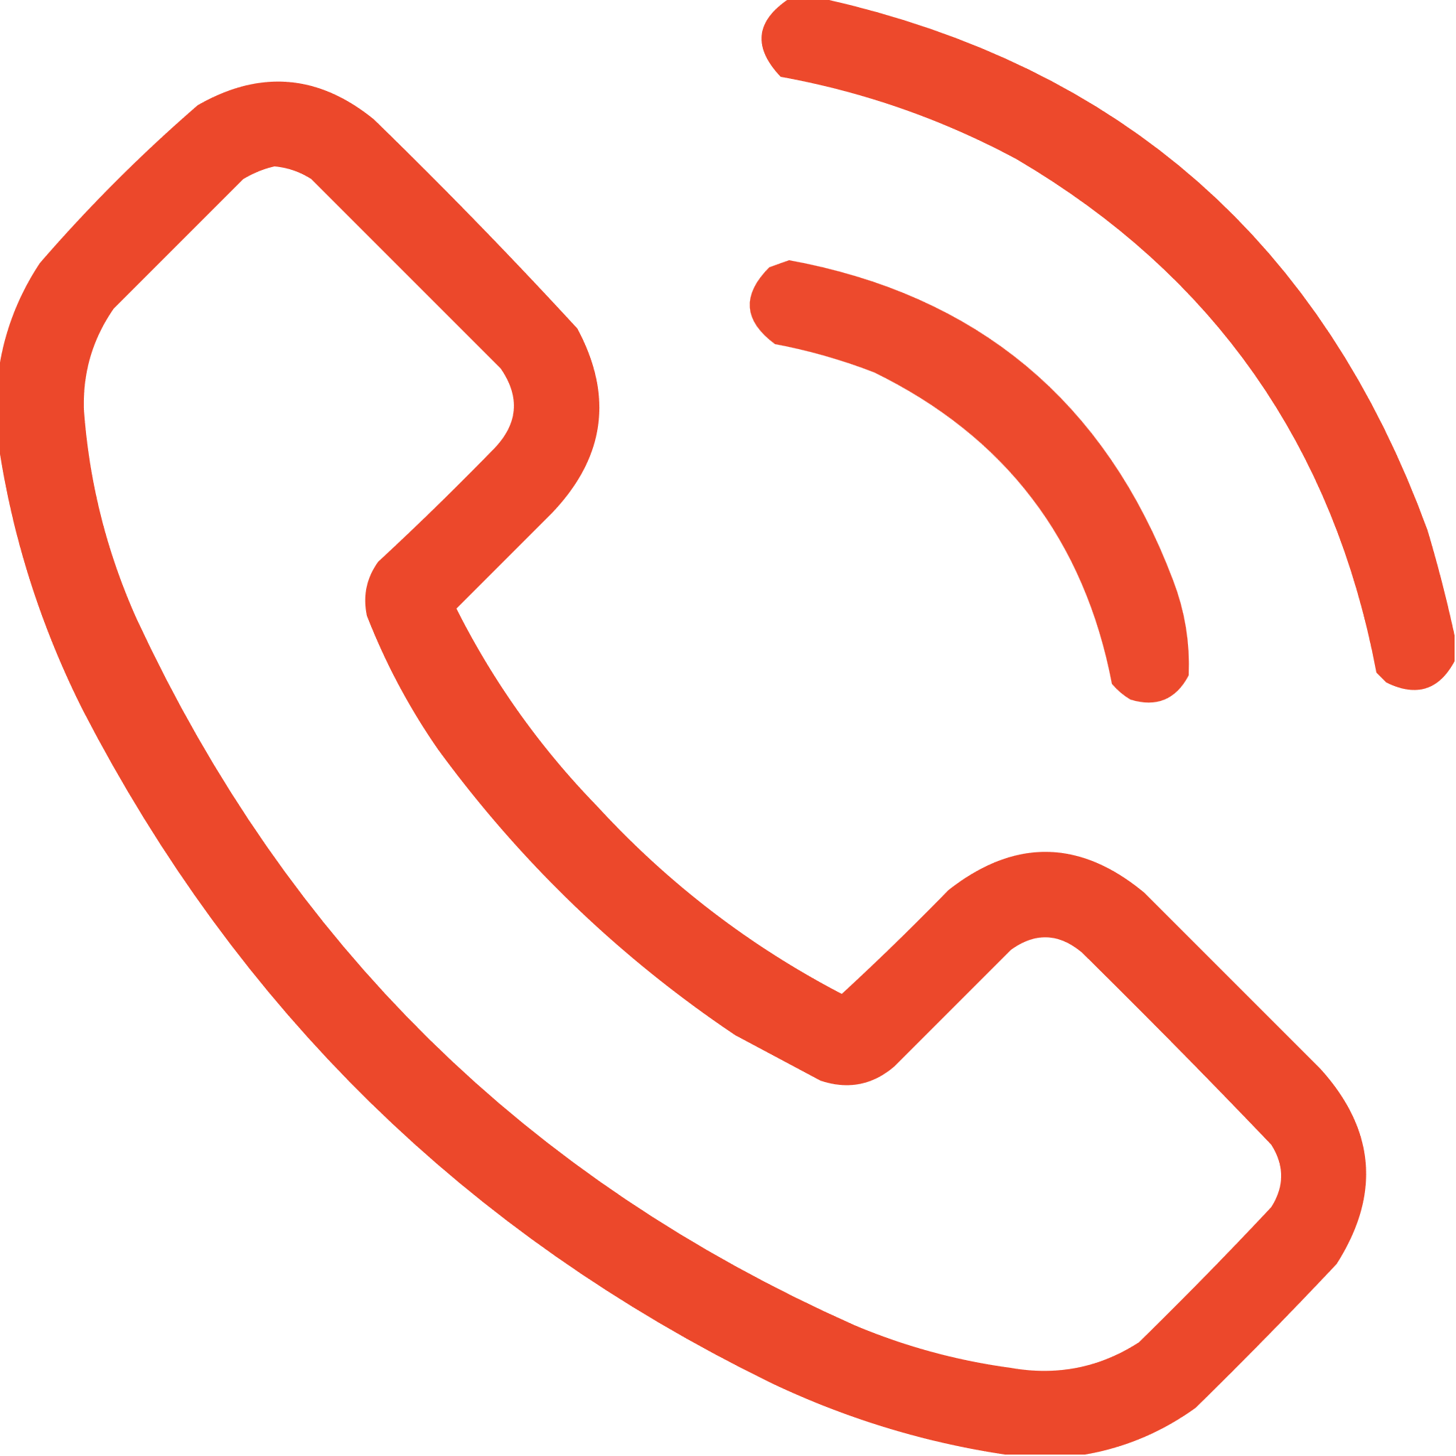
Ready to Unlock Your Website's Potential?
1
2
3
Contact Us
Take the first step in transforming your website into a lead generation powerhouse. Contact our team to learn how Visitor IQ can elevate your business and unlock the full potential of your online presence.
Schedule a Consultation
Schedule a consultation with our experts to discuss your specific business needs and how Visitor IQ can be tailored to drive measurable growth and success.
Experience The Difference
Witness the power of Visitor IQ firsthand and see how it can revolutionize your lead generation and conversion strategies. Get started today and experience the transformative impact of data-driven marketing.
sales@digital-55.com
Digital-55.com/VisitorIQ
866-665-3887

