Slide 1
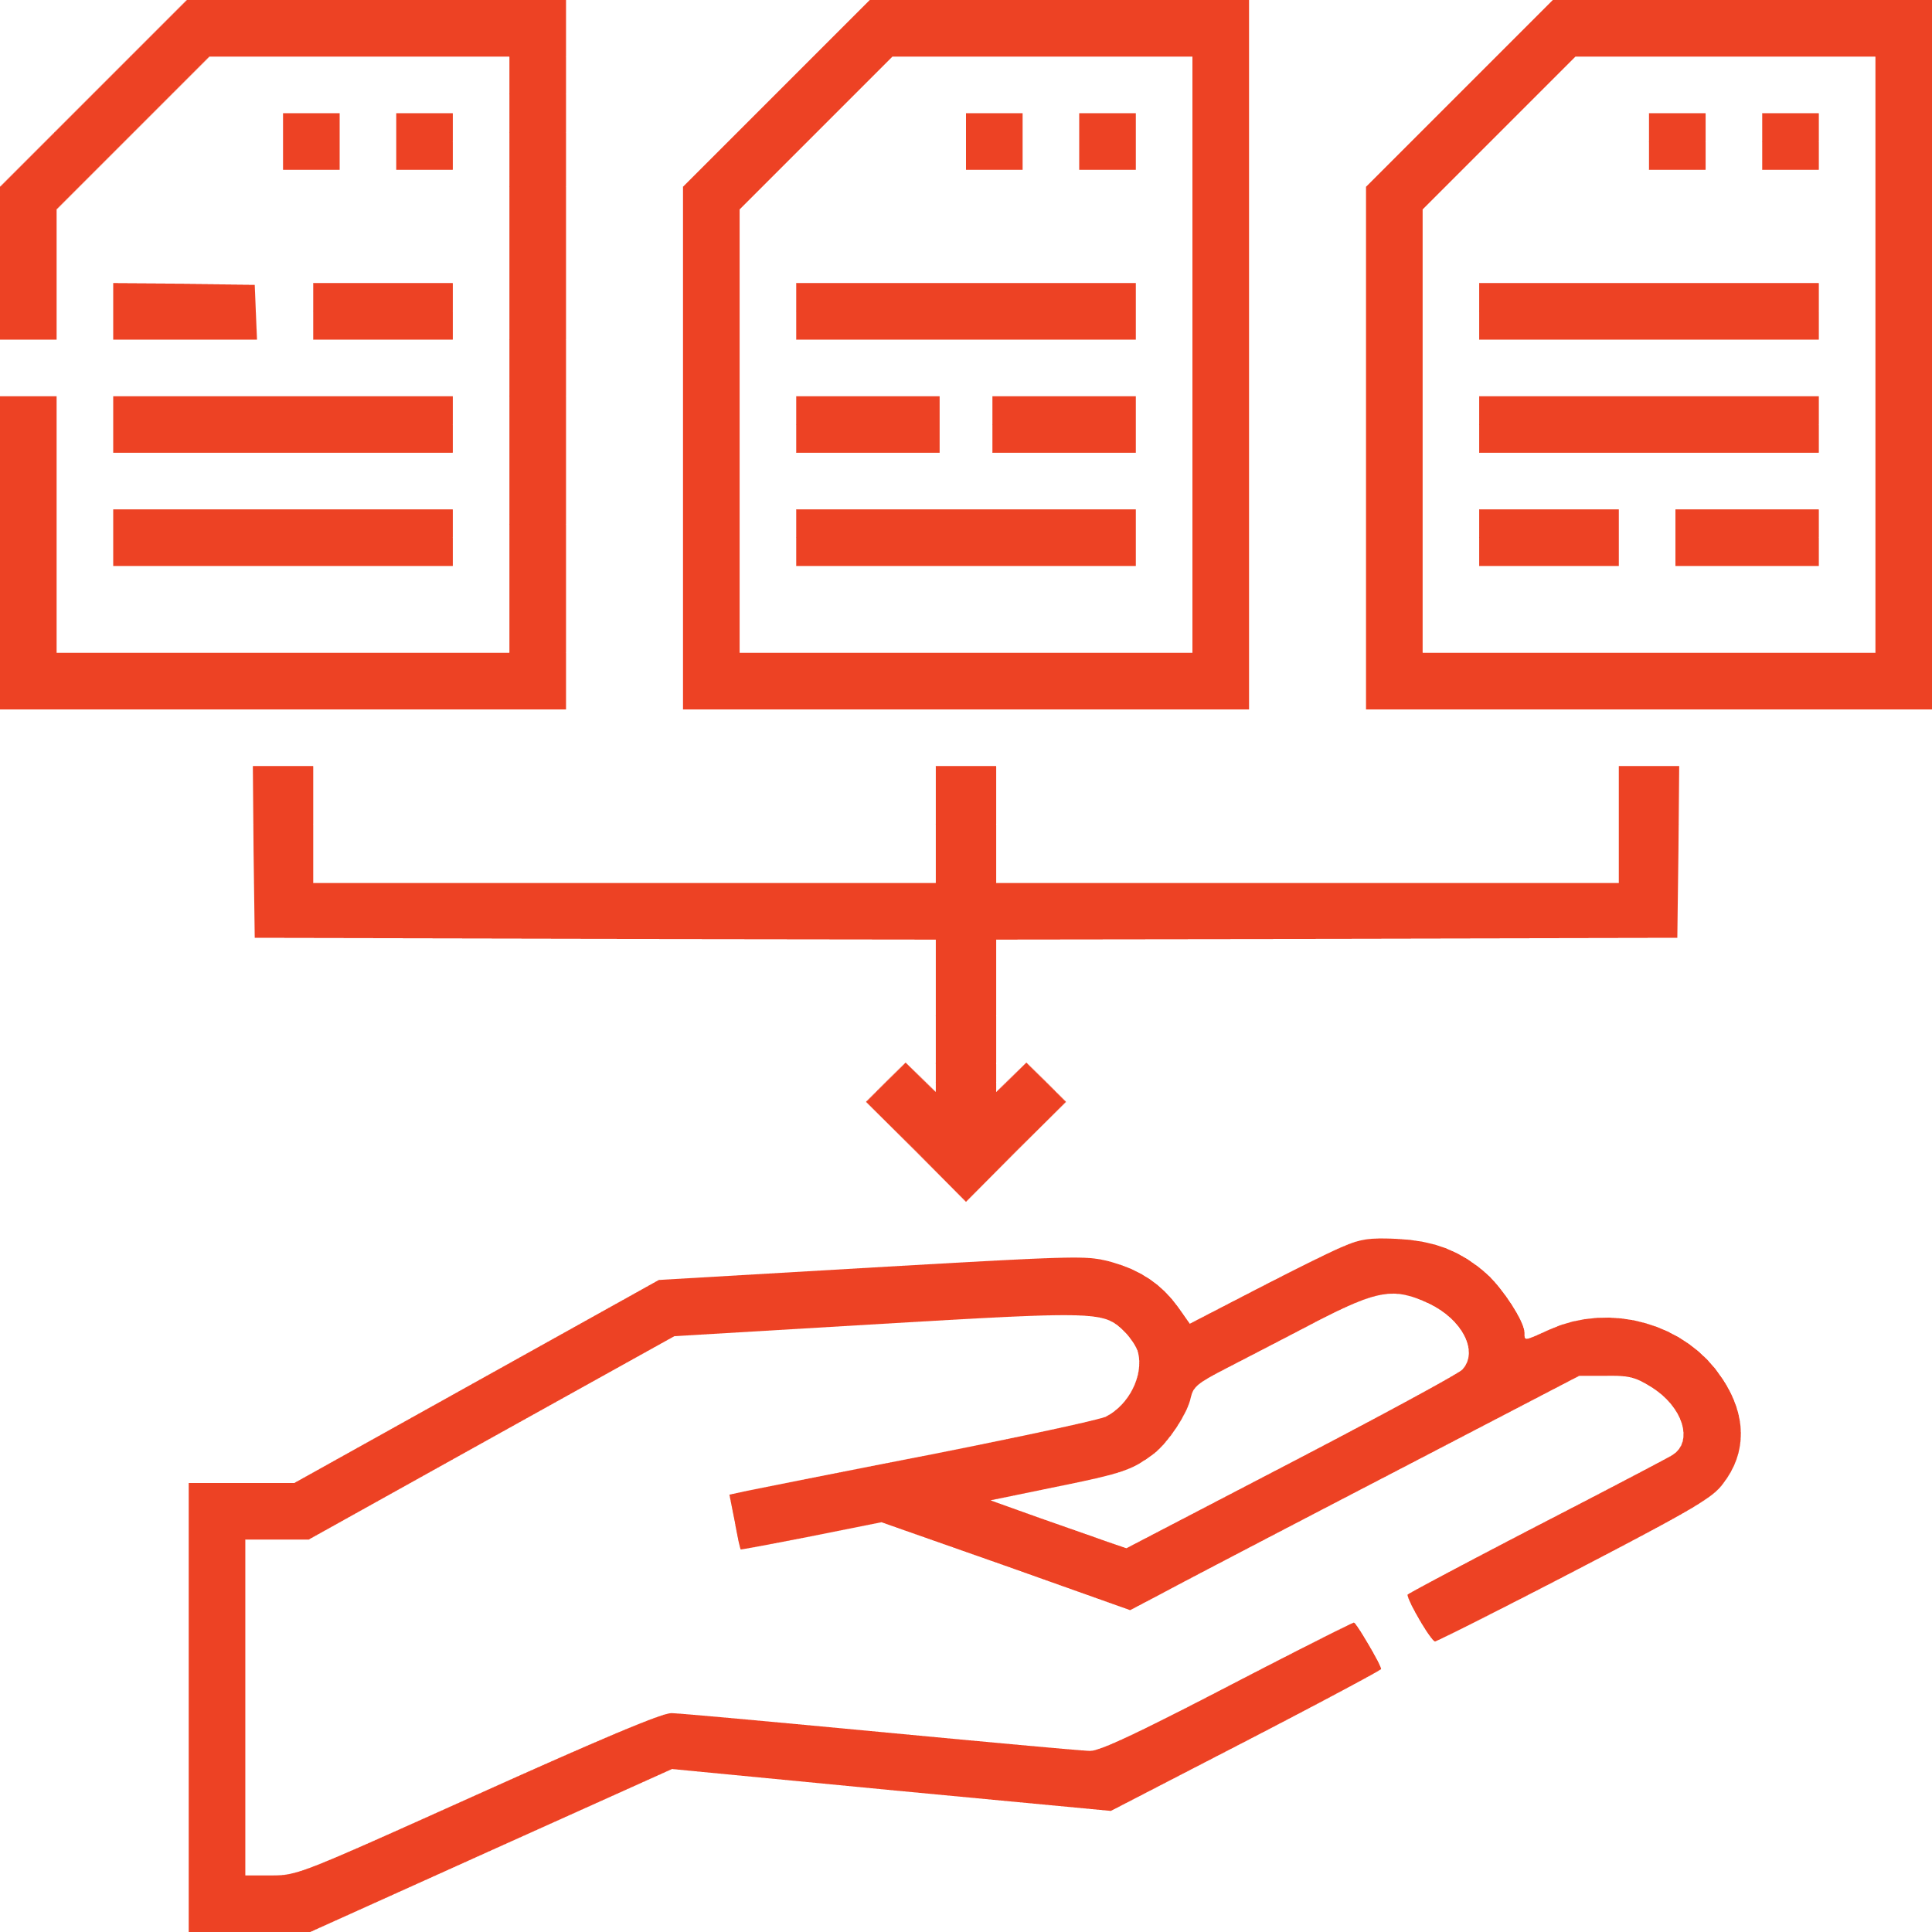
The Visitor IQ Process: Maximizing Lead Conversion
Collect
A person visits your website, triggering Visitor IQ's data capture and identification. Providing a rich understanding of your visitors' behavior and intent.
Analyze
The platform's powerful algorithms analyze the collected data, identifying valuable leads and filtering out irrelevant traffic, such as bots and automated systems.
Integrate
Visitor IQ seamlessly integrates with your CRM system, automatically updating visitor details and ensuring a streamlined lead management process.
Engage
Based on the insights gathered, Visitor IQ initiates personalized email outreach and nurturing campaigns, effectively engaging with your identified leads and driving them further down the sales funnel.
Send
Export the data for use by your organization or send it to a mailing vendor for postcard processing.

